Slide 1
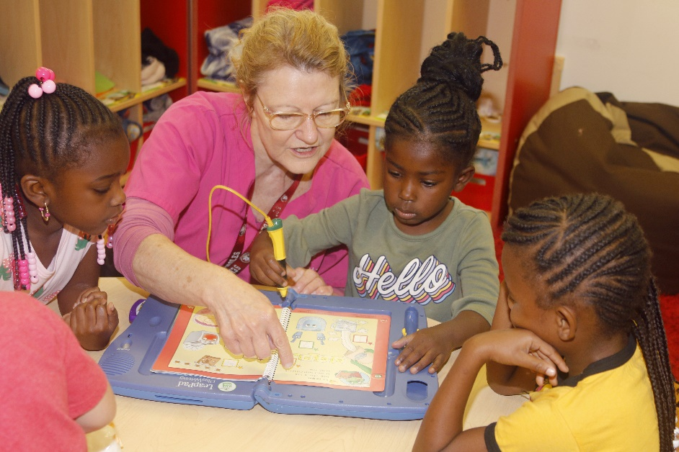
Integrating Technology
Module 1
Educators
Notes:
Trainer Does:
Introduce yourself and share the module title and subtitle.
Trainer Says:
In recent years young children have had to access technology and media more than what was previously considered developmentally appropriate. Many parents and caregivers worry about the long-term effects of too much screen time, increased access to devices and how these changes might impact children’s literacy and social-emotional skills.
The information in this module is designed to help early learning programs thoughtfully plan for the use and implementation of technology in the classroom in ways that support and complement interaction and instruction.

Slide 2
Agenda
Self-Assessment
Best Practices: Activity and Video Reflection
Guiding Principles: Discussion
Florida Early Learning and Developmental Standards: Review, Reflect, Plan
Next Steps
Notes:
Trainer Needs to Know:
Before beginning module, it will be helpful to download the following documents from the Instructional Resources, in the Technology Module from the Director’s Toolkit. http://flbt5.floridaearlylearning.com/dirtoolplm.html
Self-Assessment (Word document in Director’s Toolkit)
Activity Plans: PDF or Activity Plans | OEL (floridaearlylearning.com)
Text Rendering Experience PDF
DEL Best Practices PDF
Florida Early Learning and Developmental Standards Educator’s Guide (2017) or flbt5.floridaearlylearning.com/standards

Slide 3
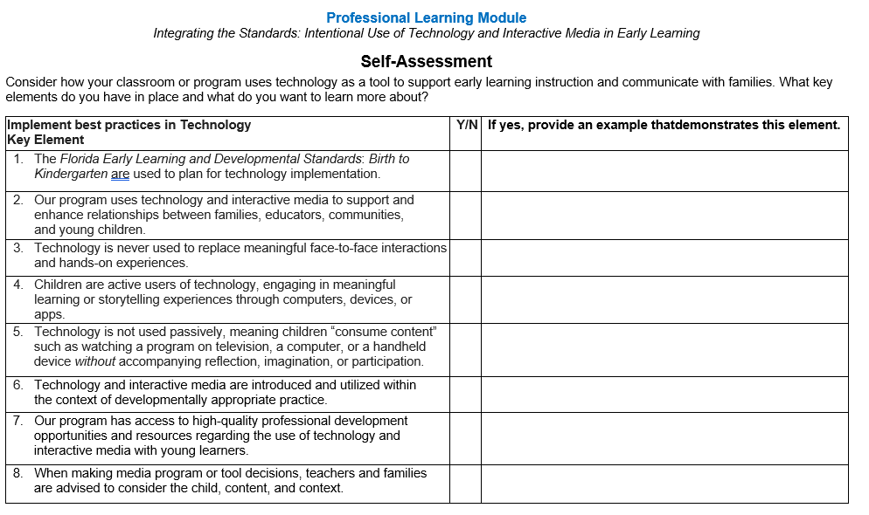
Self-Assessment
Complete the Self-Assessment
Consider how your classroom or program uses technology as a tool to support instruction and communicate with families.
Notes:
Trainer Does:
Ask participants complete Self Assessment document, found in resource section of the Director’s Toolkit: Technology Module. This document will be reviewed at the end of the module to consider when planning next steps.

Slide 4
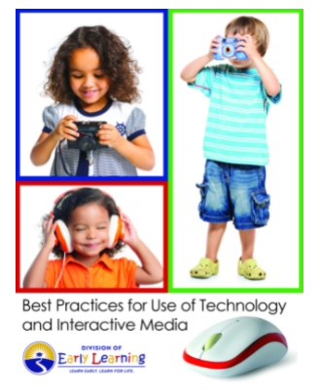
Best Practices: Activity
Read the Division of Early Learning (DEL)’s Best Practices for Use of Technology and Interactive Media.
Take a few moments to review and select a Sentence, Phrase, and Word that best describes implementation of technology in your classroom.
Share your findings.
Reflect as a group.
Notes:
Trainer Needs to Know:
Best Practices documents for this slide’s activity are found in the Florida Early Learning and Developmental Standards website.
Trainer Does:
Have participants read Best Practices for Use of Technology and Interactive Media and complete the protocol steps for the Text Rendering Experience.
Trainer Says:
As we look through the Best Practices document from DEL, highlight a sentence, and a phrase and a word that stands out to you from your assigned section.
Trainer Does:
Assign each group/person a section:
Statement of Intent
Foundational Principals
Introduction
Technology and Children
Technology and Early Childhood Professionals

Slide 5
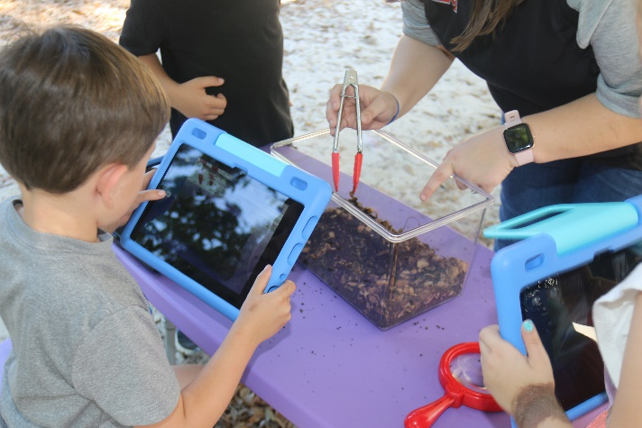
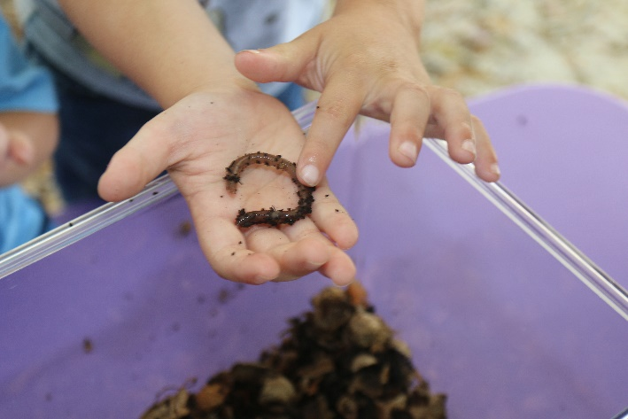
DEL Suggests
Proper use of developmentally appropriate technology and interactive media can enhance conventional methods and materials in powerful ways.
Technology should never take the place of hands-on, multi-sensory experiences. Young children are concrete thinkers and social learners.
Notes:
Trainer Says:
Let’s think about this slide and ask ourselves the following questions:
Does the technology I use allow for individual self-expression?
Do I model technology use in a way that promotes interaction?
Does our technology/media use replace interactions with teachers or peers?
Do I engage in media (videos, websites) with children rather than just “put it on”?

Slide 6
Integrating Technology and Media in the Classroom
Notes:
Trainer Does:
Click play button below image to play video (or access video at)
https://www.youtube.com/watch?v=ArnzBaiggVU&list=PL9LqBixBijCxDW-on4skuF2lA64BJmmnb&index=9&t=13s&pp=iAQB
Trainer Says:
As you watch the video, think about the answers to the following questions.
What best practices do you see being implemented?
Which Domain, component, or standard/benchmarks are being demonstrated?
Trainer Needs to Know:
This video demonstrates technology usage throughout the day at public and private VPK programs in Florida.

Slide 7
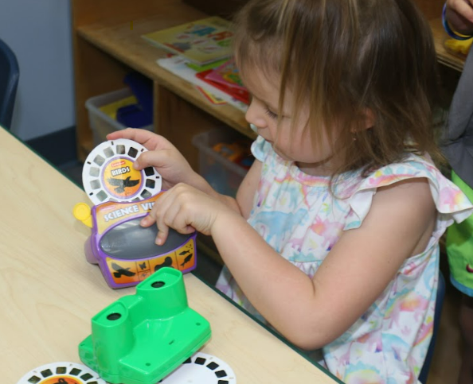
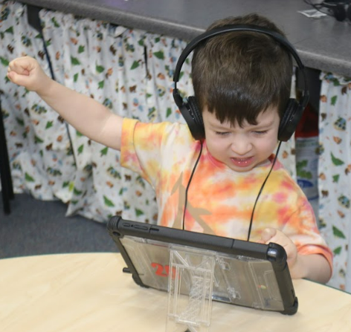
Integrating Technology and Media in the Classroom
What best practices are being implemented?
Which Florida Early Learning and Developmental Standards are being addressed?
Notes:
Trainer Says:
What best practices are being implemented?
Providing children with various types of technology
Providing children with standards-based content
Which Florida Early Learning and Developmental Standards are being addressed?
VI. Scientific Inquiry Domain
A. Scientific Inquiry Through Exploration and Discovery
2. Uses tools in scientific inquiry
benchmark a: Uses tools and various technologies to support exploration and inquiry (e.g., digital camera, scales)

Slide 8
Uses and shows awareness of technology and its impact on how people live (e.g., computers, tablets, mobile devices, cameras or music players)
Florida Early Learning and Developmental Standards
VII. Social Studies
H. Technology and Our World
Notes:
Trainer Does:
Refer to the Educator’s Guide: Four Years Old to Kindergarten for this slide and note that this is the standard under the Social Studies Domain for 4 years- Kindergarten. The Technology standards for younger age groups are found in the Educator’s Guide: Birth to Kindergarten, pages 656-661.
Trainer Says:
Technology is more than computers and tablets; it is about tools and machines that help us solve problems. From birth, children are learning cause and effect, and how to use tools to help them complete a task. This standard is what children are expected to know and do by the time they enter kindergarten. How are you currently doing this in your classroom?
Trainer Does:
Discuss developmentally appropriate technology skills and awareness for four-year-olds. Examples might include:
Know the functions of basic keys on a laptop or tablet (Enter, space bar, power button/icon)
Begins to know and understand common technology terms (digital, tablet, mouse, keyboard, battery)
Is exposed to common technology terms in the natural context of everyday conversation
Has real-world opportunities at home and school to practice skills needed to take computer assessments (not teaching to the test, but listening for directions, adjusting volume, manipulating a mouse, clicking the “next” icon, etc.)

Slide 9
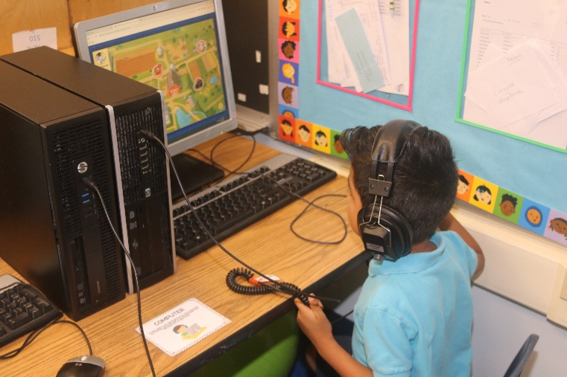
Technology and Our World: Educators May…
Provide technology tools (e.g., computers, small appliances), books about technology and dramatic play props representing technology
Notes:
Trainer Says:
This statement is found in the Educator’s Guide, from the Technology and Our World component of the Social Studies Domain.
What are some ways you currently integrate technology into the learning program?
Do you use technology and media in rotation with other learning tools such as art materials, books, and dramatic play props?
How are these images alike or different from what you have in your classroom?

Slide 10
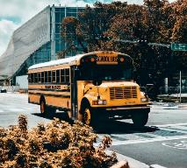
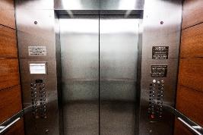
Technology and Our World: Educators May…Cont.
Discuss advantages and disadvantages of technology in everyday lives
Walking vs.
Riding the bus
Stairs vs.
Elevator
Notes:
Trainer Says:
What other themes or lessons in our curriculum can we connect to the examples on this slide?

Slide 11
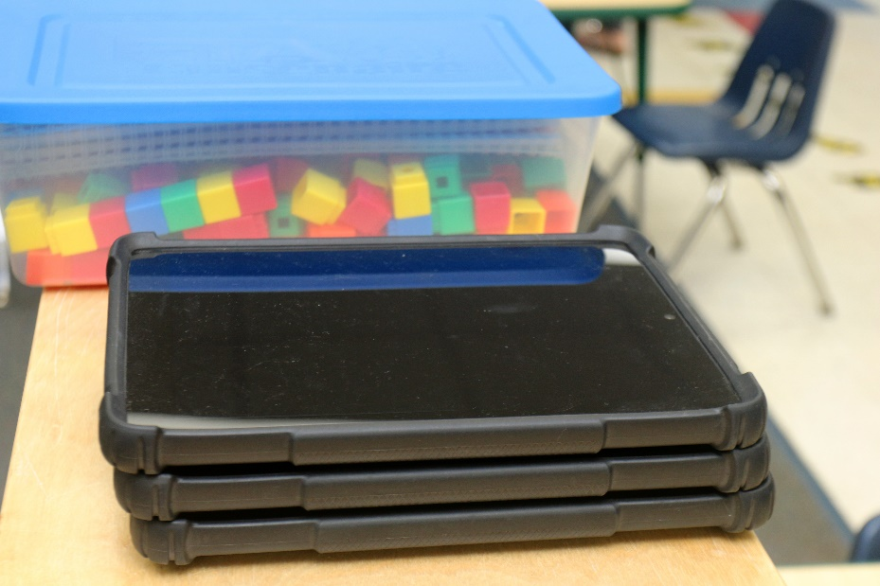
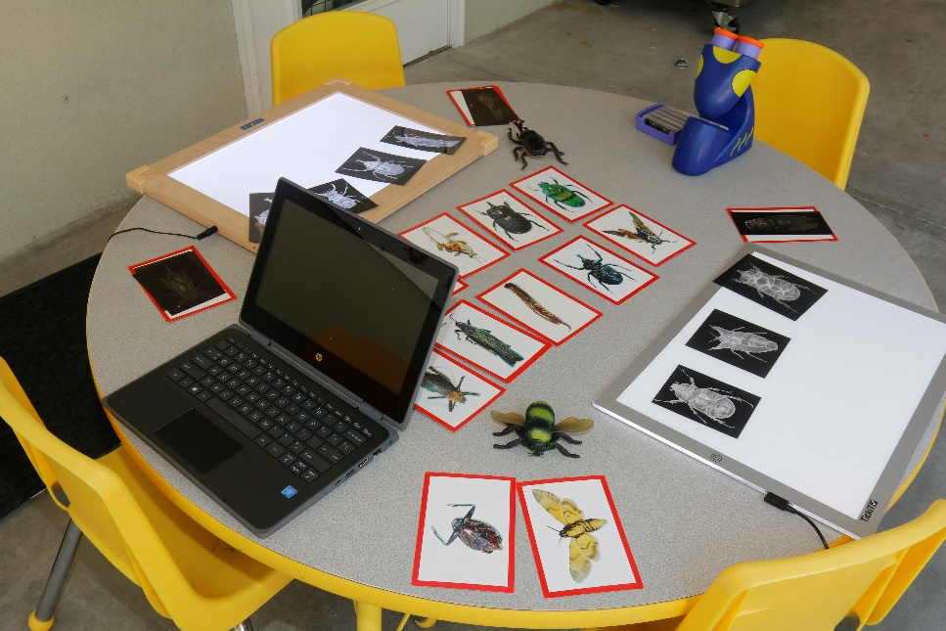
Technology and Our World: Educators May… Cont.
Introduce new technologies
Notes:
Trainer Says:
When introducing new apps or websites, it is important to research them first, and model correct usage.
When we bring a new device into the classroom, what are some ways we can introduce it in large group (circle) time?

Slide 12
Integrating the Standards
What standard or benchmark are children demonstrating when they do the following?
Use a mouse to move a cursor to a target on the screen
Know the difference between the left and right mouse button
Take a digital photo
Find the numerals on a keyboard
Type their first name on a keyboard
Notes:
Trainer Says:
We can also intentionally teach other skills when demonstrating how to operate technology devices such as computers or tablets. Using the Educator’s Guide or standards website, identify the component or standard addressed in these statements.
Trainer Needs to Know:
Example answers (participants may identify or connect to others):
Use a mouse to move a cursor to a target on the screen
Physical Development/Fine Motor
Know the difference between the left and right mouse button
Mathematical Thinking/Spatial Relations
Take a digital photo
Scientific Inquiry/Engineering and Technology
Find the numerals on a keyboard
Mathematical Thinking/Number Sense
Type their first name on a keyboard
Language and Literacy/Emergent Reading/Alphabet Knowledge

Slide 13
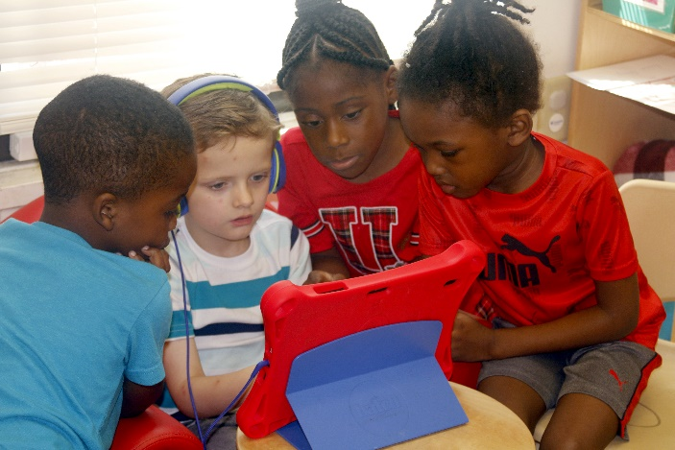
Speaking
Integrating the Standards Cont.
How can we use technology to encourage cooperative play?
Role Playing
Listening
Problem-Solving
Notes:
Trainer Says:
Let’s think about the Social Emotional Development and Language and Literacy Domains. When we introduce technology terms we are also building vocabulary.
How are the children in this photo cooperating?
How might they be demonstrating the skills and activities listed on this slide?
What are some other ways you can promote these skills in your classroom when integrating technology?
Trainer Needs to Know:
It is not appropriate to integrate technology with Emergent Writing skills, unless a child has an individualized plan that specifically requires adaptive technology.

Slide 14
Integrating the Standards Cont.
Using the Florida Early Learning and Developmental Standards Educators Guide, find and share a MATHEMATICAL THINKING or SCIENTIFIC INQUIRY standard you can enhance with technology.
Notes:
Trainer Does:
Use this slide as an individual or group activity to explore the standards.
Trainer Says: Remember – technology should enhance the experience, not BE the experience. Number sense and number and operations should be introduced through hands-on experiences before using technology to supplement instruction.
Trainer Needs to Know:
The “T” in STEM should not be confused with technological devices such as tablets, laptops, and other physical devices or with the broad term “educational technology”. The “T” in STEM, however, is intended to introduce children to the underlying concepts of building or creating technology, which is covered in the Engineering and Technology Component of the Scientific Inquiry Domain.
For example: Children can create different inclines with blocks to explore the speed of toy cars and guess which ramp the car will go down faster.

Slide 15
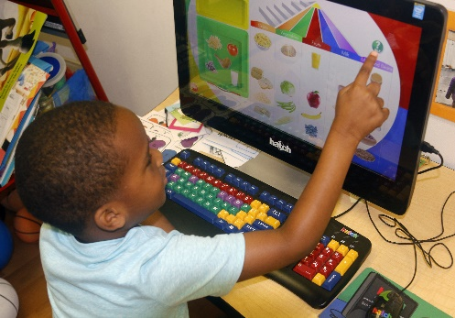
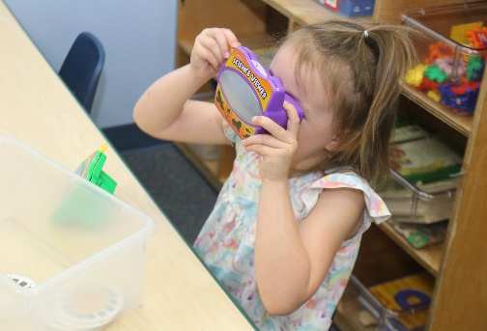
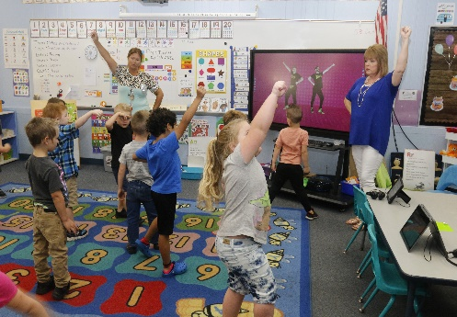
Music
Integrating the Standards
Scavenger
Hunt
Sensory
Art
Field Trip
Notes:
Trainer Does:
Use this slide as an individual or group activity to explore the standards.
Trainer Says:
Using your Educator’s Guide, identify a Social Studies OR Creative Expression through the Arts standard(s) you can address by incorporating a website or virtual experience.

Slide 16
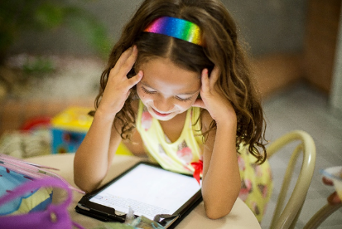
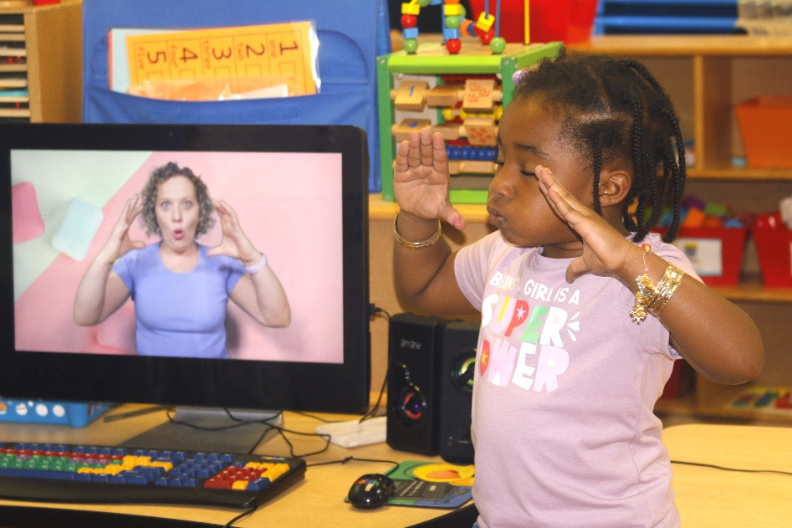
Passive vs. Active Use
Notes:
Trainer Says:
Interactive media is just what it sounds like: media that we interact with. Adults should be aware of how children are engaging with a device or program when using it, ensuring that “swiping” and clicking are enabling the child to actively learn and practice cognitive skills.
Passive: watching a video or show without accompanying reflection, imagination, or participation
Active: engaging in meaningful learning or storytelling experiences
Trainer Needs to Know:
Use this slide for interactive discussion and reflection on current passive/active use and how to improve practice. Refer to Self-Assessment document completed at beginning of module if needed.

Slide 17
Ideas for Integrating Technology
Combine digital and non-digital storytelling
Pair “tech” and “non-tech” examples in lessons
Allow children to take photos with a tablet, phone or digital camera, and create their own book/image/display
Go on a virtual field trip to a museum or zoo:
Set up different screens around your room or center to “visit” each exhibit
Science or Sensory Center: Take apart old tech tools (e.g. broken cameras, robotics, tapes)
Notes:
Trainer Says:
Have you done any of these activities in your classroom?
Ask participants to share what the children learned when conducting these activities.
What might you like to try for an upcoming theme or lesson?

Slide 18
Purposeful Planning
Notes:
Trainer Does:
Refer to Activity Plan link: Activity Plans | OEL (floridaearlylearning.com)
Trainer Says:
Here are 2 Activity Plans based on the Florida Early Learning and Developmental Standards that can be extended by using some of the technology principles we’ve discussed today. For example:
How can children be intentionally involved in taking photos for Matching Emotions?
What technology tool could you use in place of a dry erase board for What Comes Next?
Trainer Needs to Know:
Teachers may refer to their completed Self Assessment and explore other Activity Plans for other domains to see if there are plans they might expand on to encourage children to be active users of technology, and engage in meaningful learning through computers, devices, or apps.

Slide 19
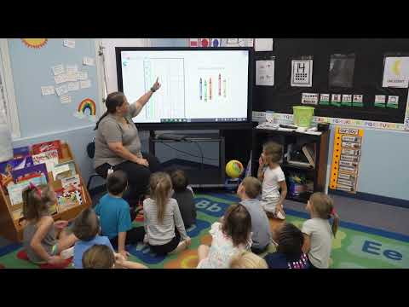
Purposeful Planning
Notes:
Trainer Does:
Click play button below image to play video (or access video at https://youtu.be/P0S2eVS61pk
Trainer Says:
As you watch the video, think about the answers to the following questions.
What best practices do you see being implemented?
Which Domain, component, or standard/benchmarks are being demonstrated?

Slide 20
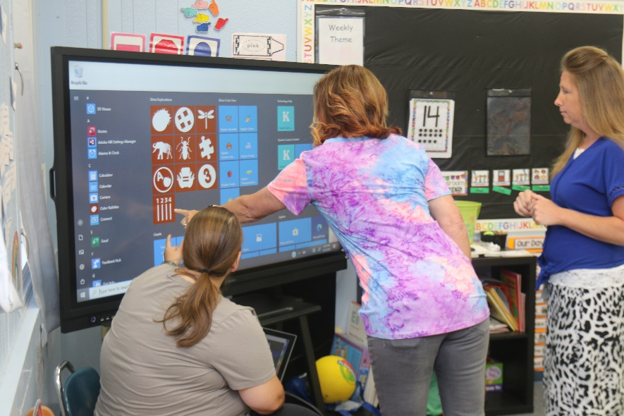
Next Steps
Review the Support Documents and Instructional Resources in the module.
Find a teacher/partner, director or coach to support you as purposefully plan for integrating technology in the classroom.
Explore additional Modules in the Director Toolkit:
Module 2 - Families
Integrating Learning Throughout the Preschool Day.
Notes:
Trainer Says:
Let’s review the Self-Assessment we completed at the beginning of this Module and identify one area to focus on when implementing technology in our classrooms. Here are some suggested next steps. Where would you like to go from here, either individually or as a group?
Trainer Needs to Know:
The websites listed on this slide are 5 of the main sources used in development in DEL’s Best Practices document and are nationally recognized as current sources for latest research and developments in early childhood technology.

